Slide 1
Unikernel
Unikernel
Analysis of the possibility to map applications and small OS on virtual machine ready for migration/consolidation on edge nodes, when real-time constraints need to be taken into account

Slide 2


Dipartimento di Elettronica, Informazione e Bioingegneria
2025
Unikernel
Milan, 29/08/2025

Slide 3
Simone Calzolaro
MSc Student
CONTACTS
simone.calzolaro@mail.polimi.it
https://www.deib.polimi.it/eng/home-page

Slide 4
Unikernel
Simone Calzolaro 260121
V1.1
29.08.2025

Slide 5
Introduction
Overview of the main scenarios and related problems

Slide 6
Cyber-Physical Systems scenario
Virtualization technology consolidates multiple systems as virtual machines (VMs) into the same platform
It allows for:
Cost reduction
Increased efficiency
Enhanced flexibility
Virtualization was initially not designed to cope with strict timing constraints: in CPS like systems timing requirements are as important as functional correctness

Slide 7
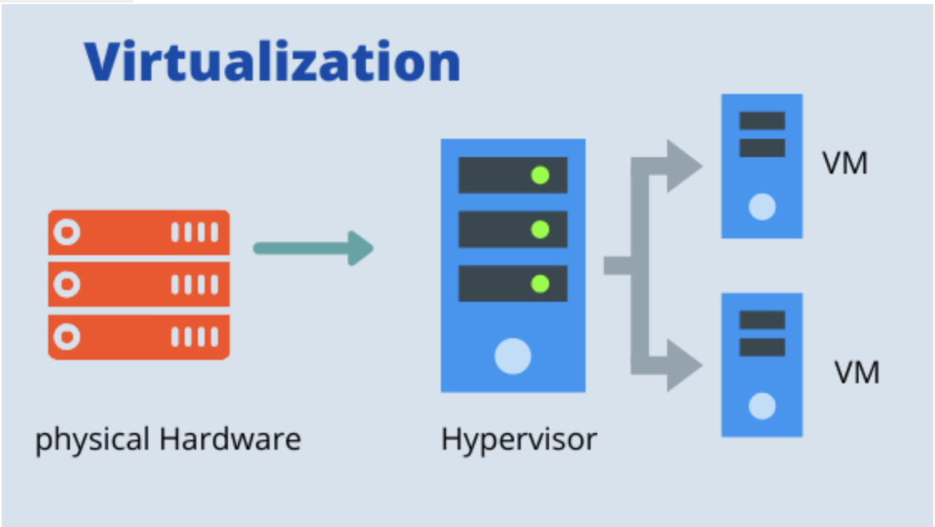
Cyber-Physical Systems scenario
Thus virtualization must be compatible to real-time software stack and satisfy the time constraints by employing hypervisor-level real-time scheduling policies

Slide 8
Cyber-Physical Systems scenario
In data-centers and cloud environments each VM is expected to to host a general purpose operating systems to ease the effort of porting legacy software
Legacy software has a lot of inherent libraries and functionalities
… it can be overkilled in some use cases ☹ …
In fact, most CPS applications are functionally dedicated single purposed, thus not dependent on additional functionalities

Slide 9

Cyber-Physical Systems scenario
Due to the encapsulation of superfluous libraries and the execution of non-essential processes, that are not related to the task of interest, deploying real-time tasks of CPS on a general purpose OS arises various issues:
Resources efficiency
Timing predictability

Slide 10
Cyber-Physical Systems scenario
Measured worst-case response time (WCRT) with unikernel VMs under Xen + deferrable servers (RTDS): (see later)
VM | Min | Mean | σ | WCRT (meas.) | WCRT (bound)
VM1 | 1.00 ms | 1.11 ms | 0.047 ms | 1.215 ms | 1.25 ms
VM2 | 3.88 ms | 4.42 ms | 0.49 ms | 5.83 ms | 12.25 ms
VM3 | 7.86 ms | 10.99 ms | 2.02 ms | 14.03 ms | 26.25 ms
VM4 | 8.84 ms | 15.54 ms | 5.14 ms | 27.83 ms | 79.25 ms

Slide 11
Embedded Systems scenario
In the era of Big Data, more and more applications of smart devices are computing-intensive
Strong demand for task offloading to cloud data centers
However this gives rise to network delay and privacy data leak issues

Slide 12
Embedded Systems scenario
Edge computing can effectively solve:
Latency
Bandwidth occupation
Data privacy problems
However the deployment of applications are also limited by hardware resources
With the fast development of Internet of Things more and more smart devices are connected to the Internet

Slide 13
Embedded Systems scenario
These devices inevitably produce large amounts of data
Moreover 5G technology can increase network bandwidth and reduce the latency of data transmission
So we face the storage and computing pressure for big data and the geographical limitation of a cloud center
In addition many latency-sensitive applications need milliseconds or even microseconds response time

Slide 14
Embedded Systems scenario
Comparison between Docker containers and Unikraft unikernels:
Why it matters at the edge: milliseconds-level start and tiny images enable on-demand spin-up near sensors/actuators with limited storage and power
 | Cold-Start (boot) | Footprint
Docker | 508.355 ms | 109 MB
Unikraft | 3.188 ms | 1.9 MB

Slide 15
What is a Unikernel?
Description and definition of the technology, main aspects, architecture and use cases

Slide 16

Basics of Unikernel
Unikernel are sealed, single-purposed virtual machines (VMs) images that can be constructed using the concept of library operating system (LibOS)
Unikernel instance is intended to run a single application, hence it include only a minimal amount of system software code required to execute that application

Slide 17
Basics of Unikernel
This leads to a significant reduction in:
Memory/Disk footprint
Boot time
Attack surface
When compared to traditional virtual machines
LibOS’s allow forn the tailoring of an OS code base to the particular needs of a given task
Only those parts of the OS API are included in the VM image

Slide 18
Basics of Unikernel
Unikernels are characterized by a minimal VM image size which highly increase their security properties
Due to the minimal attack surface for malicious code injection
This also translates to a substantial reduction of overall system’s resource usage
Moreover, Unikernels can be instantiated and become fully functional within only a few milliseconds

Slide 19
Basics of Unikernel
Boot time and image size:
 | Boot Time | Image Size
Container | 508 ms | 109 MB
Unikernel | 3.19 ms | 1.9 MB

Slide 20
Basics of Unikernel
It has further been shown that unikernels are more efficient and safer than modern container technologies
Unikernels have several advantages:
High-security
High start-up speed
High simplicity
It has attracted the researcher’s interest in the field of virtualization
Unikernel is the state-of-the-art virtualization technology

Slide 21
Definition and Characteristics of Unikernel
Unikernel is a specialized, single-address space image constructed by library operating systems (LibOSs)
Unikernel’s essence is a kind of image file with special purpose
In order to support the execution of programs, developer select the smallest set of class libraries from a module stack, together with application code and configuration files
All built into a dedicated image file
So Unikernels have a smaller code base and only run the components that are required for the specific application
Resulting in a smaller overall footprint

Slide 22
Definition and Characteristics of Unikernel
Unikernels improve performance by removing unnecessary components from applications
Unikernel is a single-purpose appliance that is specialized at compile time into a stand-alone kernel and is protected from modification after deployment
Individual applications can be isolated in Unikernels, reducing the risk of cross-application interference
They are self-contained and do not require a separate runtime environment

Slide 23
Definition and Characteristics of Unikernel
So they can be deployed quickly and easily
However, because of their limited runtime environment, unikernels are more vulnerable to security threats
Due to the limited runtime environment and lack of standard tools, debugging unikernel can be difficult
They also increase security by reducing the attack surface

Slide 24
Definition and Characteristics of Unikernel
Unikernels may have a distinct set of vulnerabilities
An attacker who successfully penetrates one may be unable to threaten others
Unikernel can run directly on such hypervisors such as:
Xen
Kernel-based Virtual Machine (KVM)
Hardware without operating system

Slide 25
Definition and Characteristics of Unikernel
Syscall surface comparison:
Linux: exposes 393 syscalls
Unikraft: exposes 146 syscalls
Nanos: exposes 148 syscalls

Slide 26
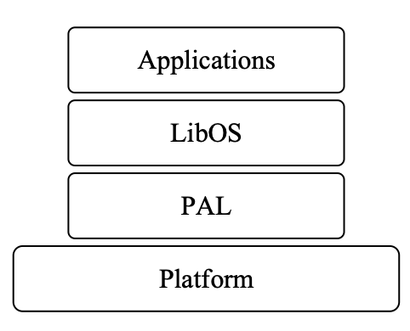
Architecture of Unikernel
Unikernel is divided into 3 layers over hardware platform or hypervisor:
Application layer
LibOS layer
Platform Adaptation Layer (PAL)

Slide 27
Architecture of Unikernel
User applications run at the application layer
These application programs are generally:
Single function
Small size
High-performance
Which are convenient for fast deployment
Their characteristics conform to microservice application
LibOS is at the middle layer

Slide 28
Architecture of Unikernel
It is specifically divided into a kernel base and functional system
LibOS complete the basic functions of an OS:
Task scheduling
Thread management
Platform Adaptation Layer are the minimum core components to support application execution

Slide 29
Architecture of Unikernel
PAL includes:
An adaptation layer with host environments running on a bare machine
A virtual environment running on a hypervisor
PAL is used mainly for LibOS application migration and need not change LibOS or application code when hardware is updated

Slide 30
Use cases of Unikernel
Unikernel was originally intended for cloud computing
However, its small footprint and flexibility make it ideal for other applications:
Real-time applications: unikernels are lightweight and efficient, so they can handle real-time applications
Edge-gateways: acting as a middleman between devices and the cloud
Autonomous vehicles: unikernels can be used in self-driving cars to provide real-time data processing and decision making capabilities
Cloud-Native Edge computing
Network functions

Slide 31
Use cases of Unikernel – Short numeric sub-case
Microservices/REST services
Throughput (single thread):
Go: +38%
Java: +16%
Python: +15%
requests/s for OSv unikernel vs. Docker
Heavy compute (CPU-bound):
Go: 3% slower
Java: 1% faster

Slide 32
The choice of Unikernels
The choice of unikernels are driven by a variety of factors:
Resource efficiency: unikernels are compact and efficient, making them excellent for edge computing applications where hardware resources are restricted
Security: because of their small size unikernels have a lower attack surface, resulting in a higher degree of protection
Isolation: provide good isolation between diverse workloads, they are ideal for instances where numerous tenants share the same hardware
Simplified management: unikernel facilitate the management and deployment of applications at the edge by minimizing the overhead of standards OSs

Slide 33
Unikernel-Based Real-Time Virtualization under Deferrable Servers
Analysis and Realization

Slide 34
Introduction
Real-time virtualization optimized the hardware utilization by consolidating multiple systems into the same platform
While satisfying the timing constraints of their real-time tasks
We consider here virtualization based on Unikernels
Each Unikernel is a guest operating system in the virtualization and hosts a single real-time task
We consider deferrable server in the virtualization platform to schedule the unikernel-based guest operating systems and analyze the worst-case response time of a sporadic real-time task under such a virtualization architecture

Slide 35
Introduction
Virtualization must be compatible to real-time software stack and satisfy the time constraints by employing hypervisor-level scheduling policies
The Xen hypervisor, periodic server-based approach have been widely used
Especially deferrable servers
Each virtual CPU (vCPU) is treated as one deferrable server assigned with an execution budget and a replenishment

Slide 36
Introduction
The scheduling decision involves 2 levels:
The hypervisor scheduler
The scheduler within the VMs
In a hierarchical manner
To account for the interplay of servers and tasks, the applicability of such server based approaches is based on the tightness of corresponding worst-case response time analyses

Slide 37
Introduction
Main types of tasks in real-time systems:
Periodic: Tasks that activate at regular, fixed intervals.
Sporadic: Tasks that arrive irregularly, but with a minimum inter-arrival time between jobs.
Aperiodic: Tasks that arrive randomly, with no minimum time between jobs.

Slide 38
Goals
We present why unikernel-based virtualization can facilitate the schedulability of deferrable servers
We explain how to realize our unikernel-based approach on top of the Xen hypervisor with a few design details

Slide 39
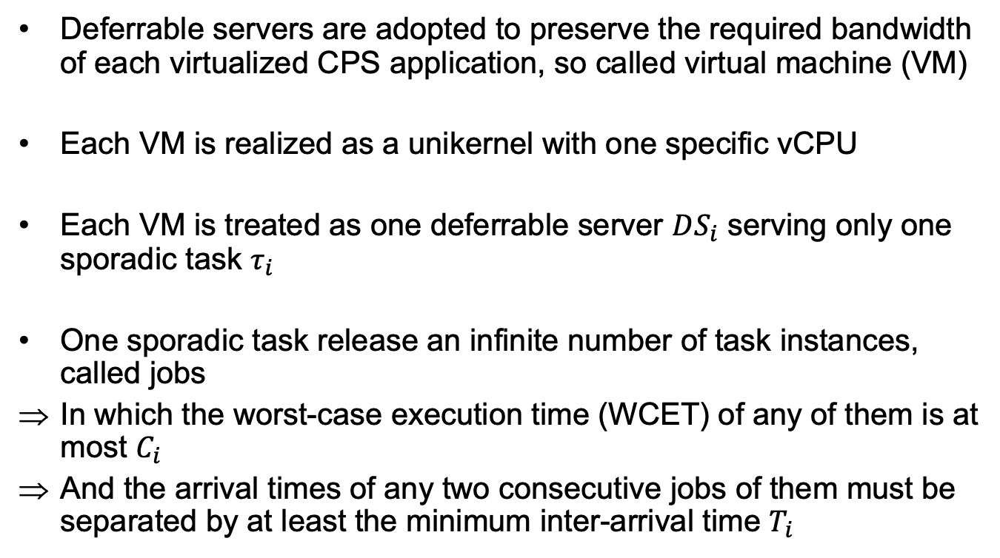
Deferrable Server and Task model
Deferrable servers are adopted to preserve the required bandwidth of each virtualized CPS application, so called virtual machine (VM)
Each VM is realized as a unikernel with one specific vCPU
Each VM is treated as one deferrable server $DS_{i}$ serving only one sporadic task $τ_{i}$
One sporadic task release an infinite number of task instances, called jobs
In which the worst-case execution time (WCET) of any of them is at most $C_{i}$
And the arrival times of any two consecutive jobs of them must be separated by at least the minimum inter-arrival time $T_{i}$

Slide 40
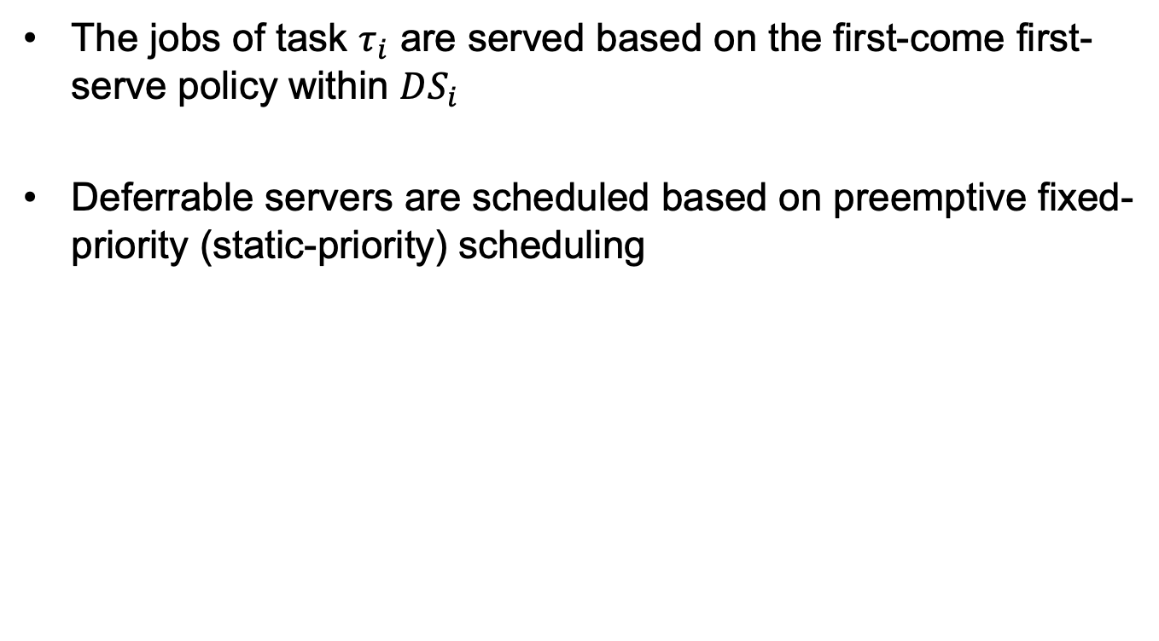
Deferrable Server and Task model
The jobs of task $τ_{i}$ are served based on the first-come first-serve policy within $DS_{i}$
Deferrable servers are scheduled based on preemptive fixed-priority (static-priority) scheduling

Slide 41
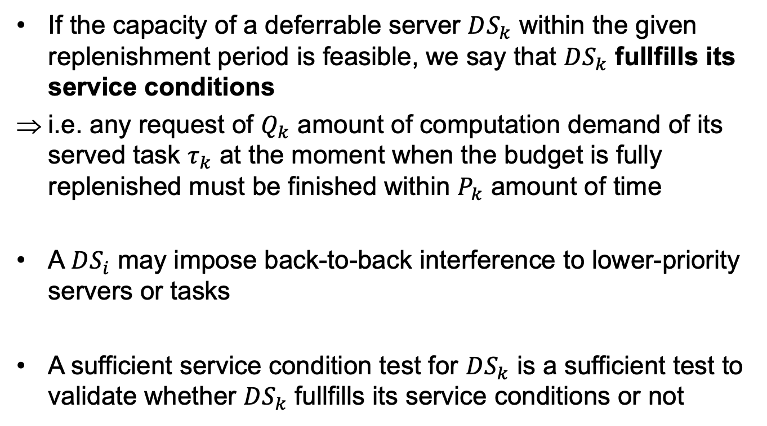
Service Condition and Execution Scenarios of Deferrable servers
If the capacity of a deferrable server $DS_{k}$ within the given replenishment period is feasible, we say that $DS_{k}$ fullfills its service conditions
i.e. any request of $Q_{k}$ amount of computation demand of its served task $τ_{k}$ at the moment when the budget is fully replenished must be finished within $P_{k}$ amount of time
A $DS_{i}$ may impose back-to-back interference to lower-priority servers or tasks
A sufficient service condition test for $DS_{k}$ is a sufficient test to validate whether $DS_{k}$ fullfills its service conditions or not

Slide 42
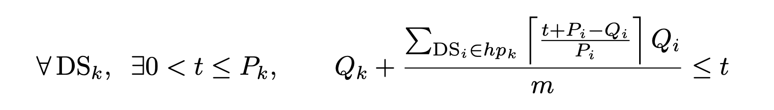
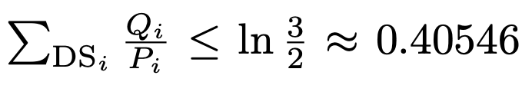
Service Condition and Execution Scenarios of Deferrable servers
Sufficient service condition for uniprocessor preemptive fixed-priority scheduling of systems composed of only fixed-priority deferrable servers:
The equation ensures that the condition stated in the previous equation hold

Slide 43
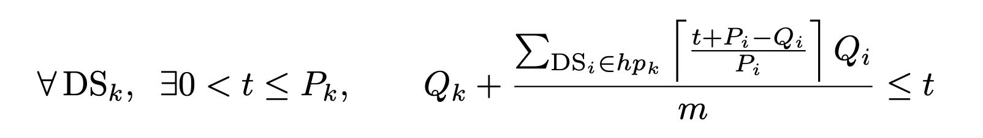
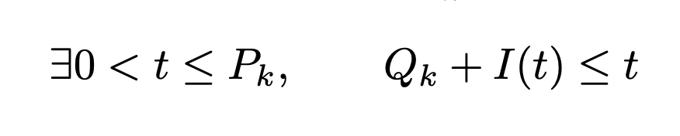
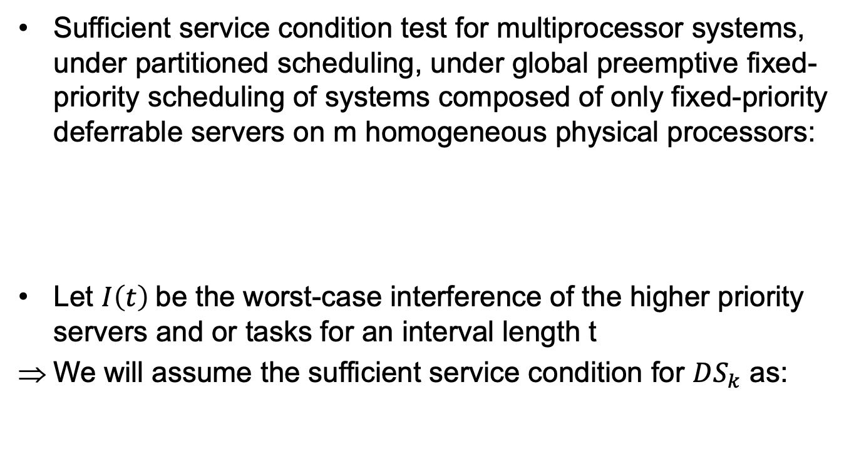
Service Condition and Execution Scenarios of Deferrable servers
Sufficient service condition test for multiprocessor systems, under partitioned scheduling, under global preemptive fixed-priority scheduling of systems composed of only fixed-priority deferrable servers on m homogeneous physical processors:
Let $I\left(t\right)$be the worst-case interference of the higher priority servers and or tasks for an interval length t
We will assume the sufficient service condition for $DS_{k}$ as:

Slide 44
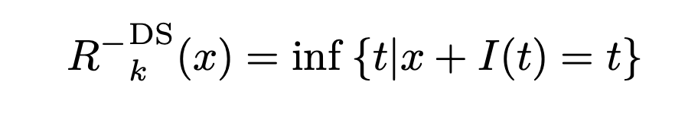
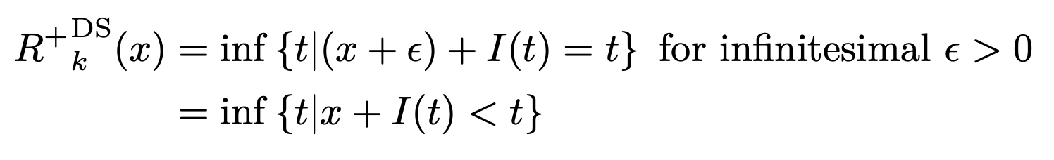
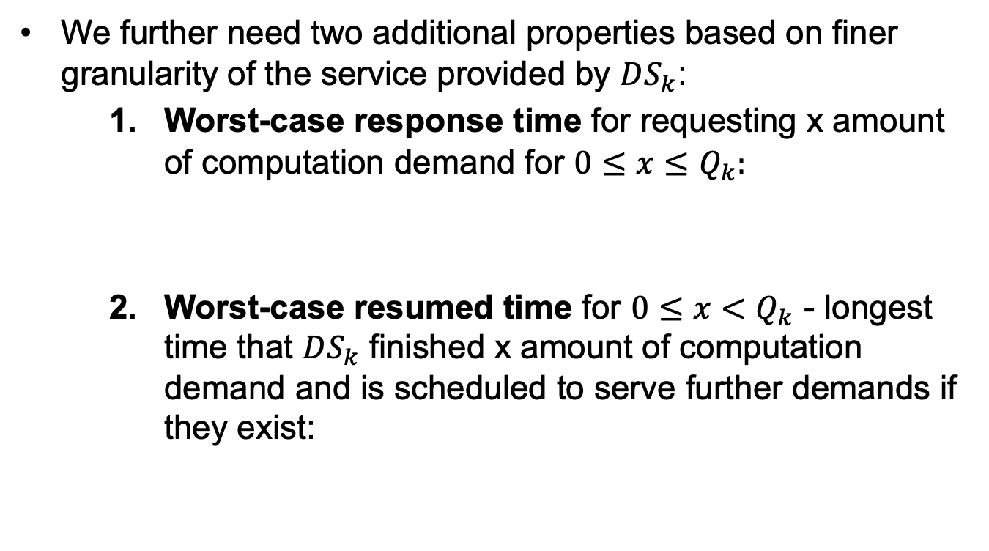
Service Condition and Execution Scenarios of Deferrable servers
We further need two additional properties based on finer granularity of the service provided by $DS_{k}$:
Worst-case response time for requesting x amount of computation demand for $0≤x≤Q_{k}:$
Worst-case resumed time for $0≤x<Q_{k}$ - longest time that $DS_{k}$ finished x amount of computation demand and is scheduled to serve further demands if they exist:

Slide 45
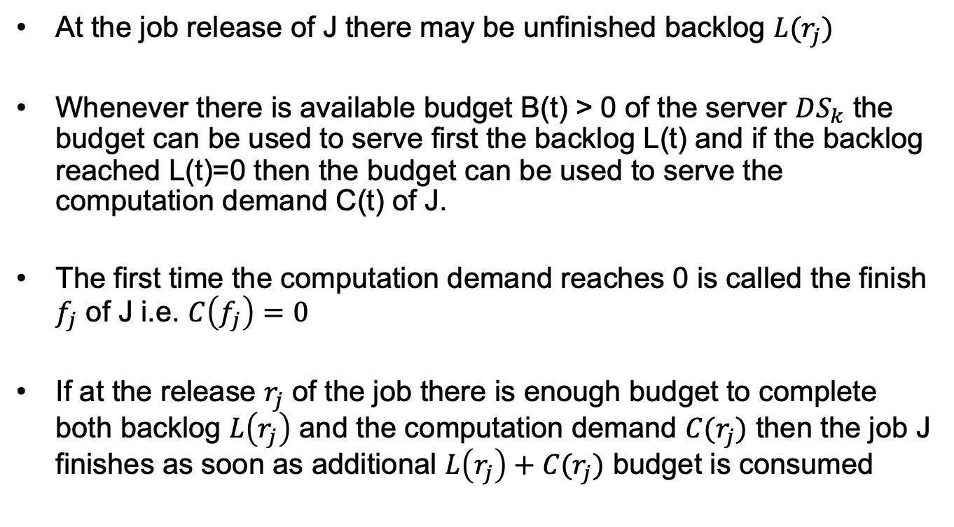
Service Condition and Execution Scenarios of Deferrable servers
At the job release of J there may be unfinished backlog $L(r_{j})$
Whenever there is available budget B(t) > 0 of the server $DS_{k}$ the budget can be used to serve first the backlog L(t) and if the backlog reached L(t)=0 then the budget can be used to serve the computation demand C(t) of J.
The first time the computation demand reaches 0 is called the finish $f_{j}$ of J i.e. $C\left(f_{j}\right)=0$
If at the release $r_{j}$ of the job there is enough budget to complete both backlog $L\left(r_{j}\right)$ and the computation demand $C(r_{j})$ then the job J finishes as soon as additional $L\left(r_{j}\right)+C(r_{j})$ budget is consumed

Slide 46
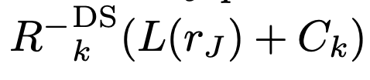
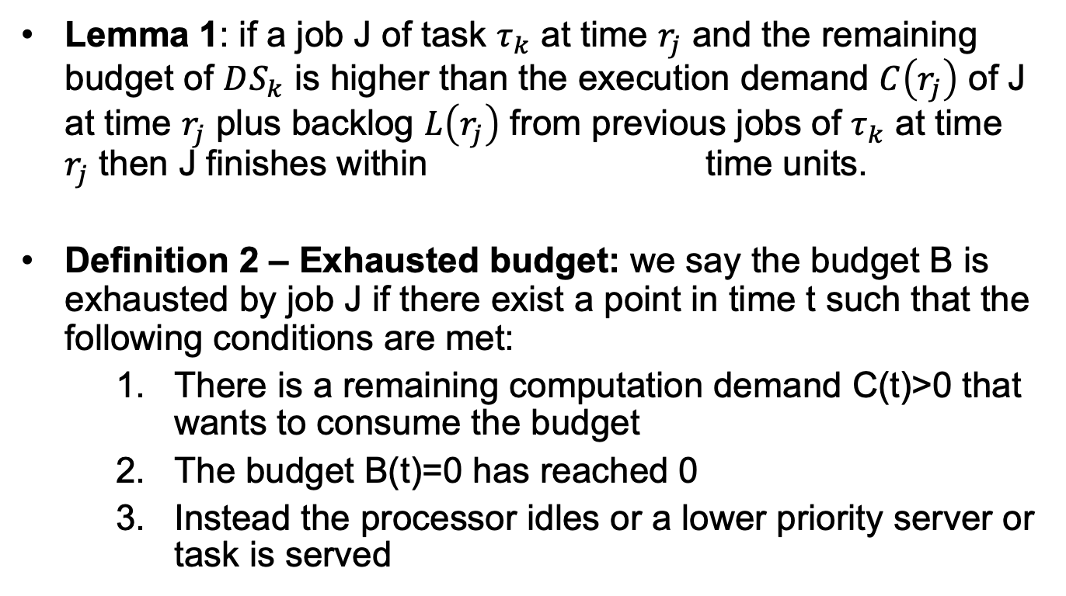
Service Condition and Execution Scenarios of Deferrable servers
Lemma 1: if a job J of task $τ_{k}$ at time $r_{j}$ and the remaining budget of $DS_{k}$ is higher than the execution demand $C\left(r_{j}\right)$ of J at time $r_{j}$ plus backlog $L\left(r_{j}\right)$ from previous jobs of $τ_{k}$ at time $r_{j}$ then J finishes within time units.
Definition 2 – Exhausted budget: we say the budget B is exhausted by job J if there exist a point in time t such that the following conditions are met:
There is a remaining computation demand C(t)>0 that wants to consume the budget
The budget B(t)=0 has reached 0
Instead the processor idles or a lower priority server or task is served

Slide 47
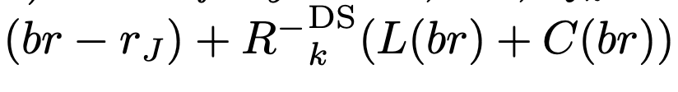
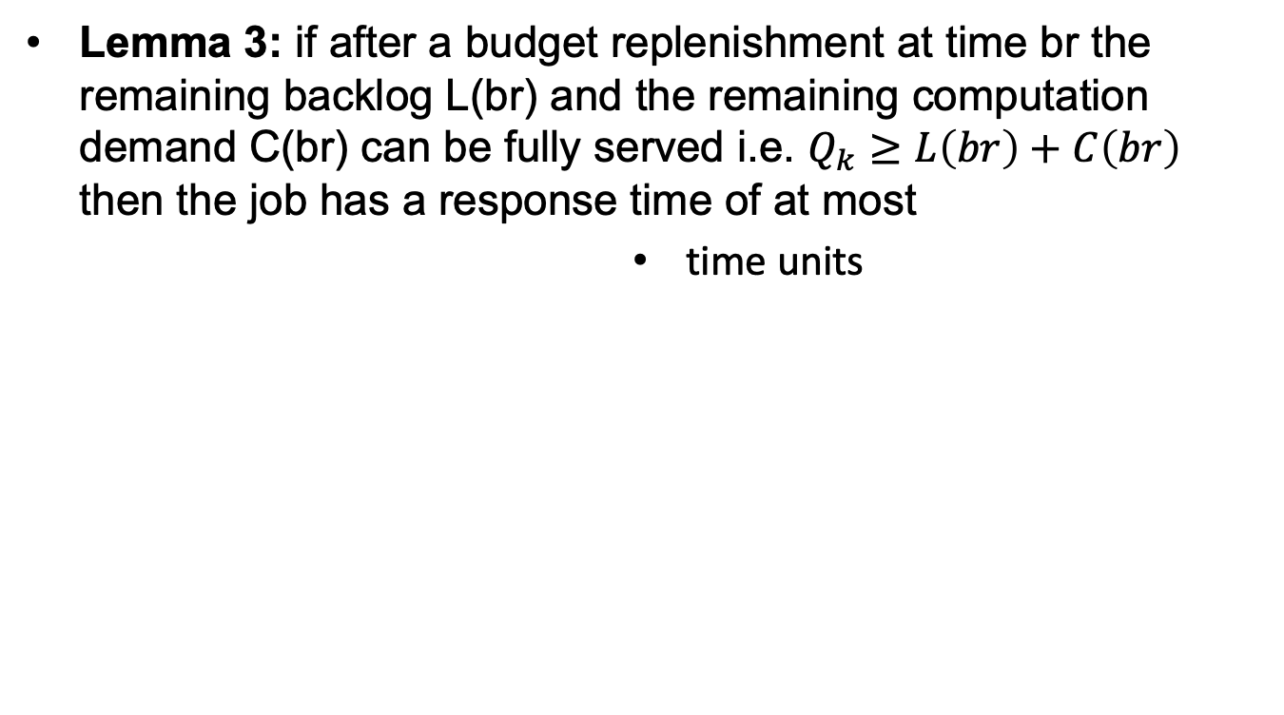
Service Condition and Execution Scenarios of Deferrable servers
Lemma 3: if after a budget replenishment at time br the remaining backlog L(br) and the remaining computation demand C(br) can be fully served i.e. $Q_{k}≥L\left(br\right)+C\left(br\right)$ then the job has a response time of at most
time units

Slide 48
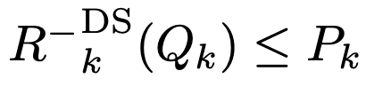
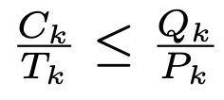
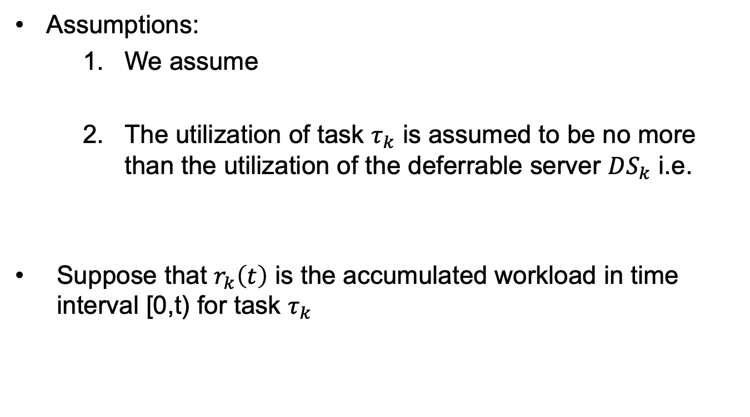
Worst-Case Response Time Analysis for One Single Task
Assumptions:
We assume
The utilization of task $τ_{k}$ is assumed to be no more than the utilization of the deferrable server $DS_{k}$ i.e.
Suppose that $r_{k}\left(t\right)$ is the accumulated workload in time interval [0,t) for task $τ_{k}$

Slide 49
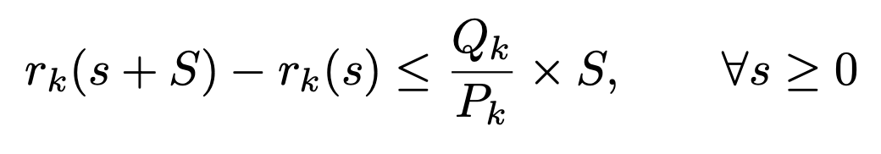
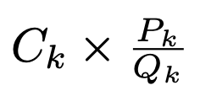
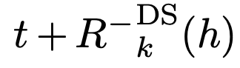
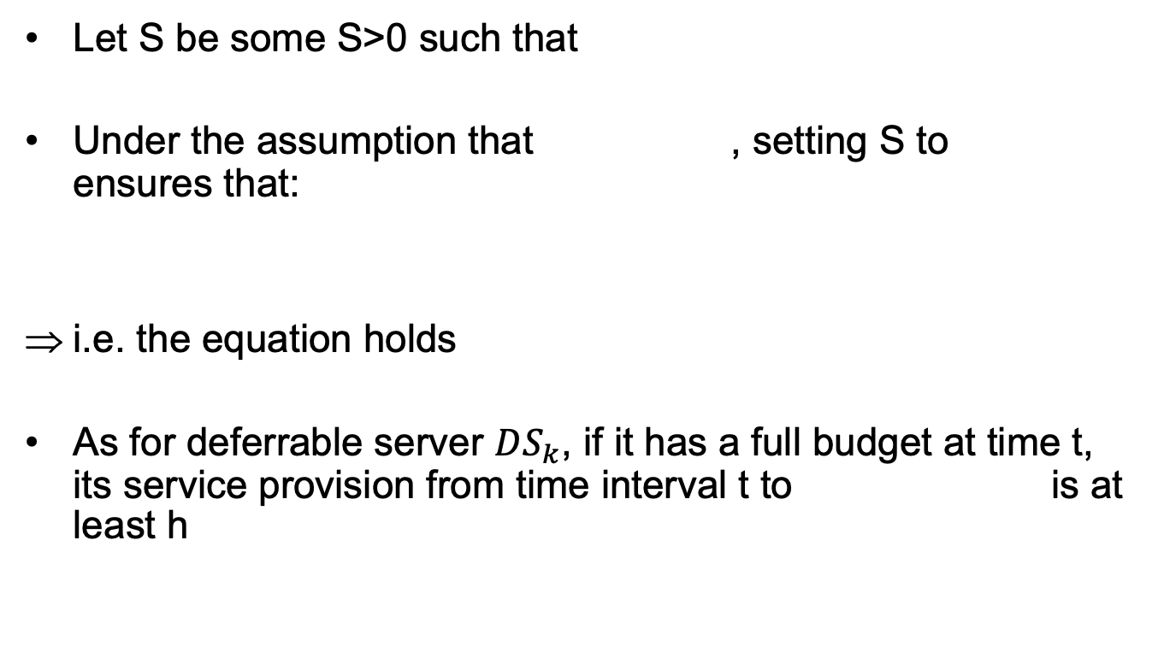
Worst-Case Response Time Analysis for One Single Task
Let S be some S>0 such that
Under the assumption that , setting S to ensures that:
i.e. the equation holds
As for deferrable server $DS_{k}$, if it has a full budget at time t, its service provision from time interval t to is at least h

Slide 50
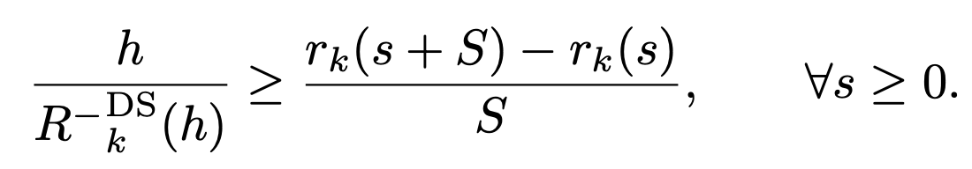
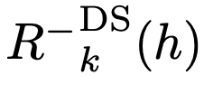
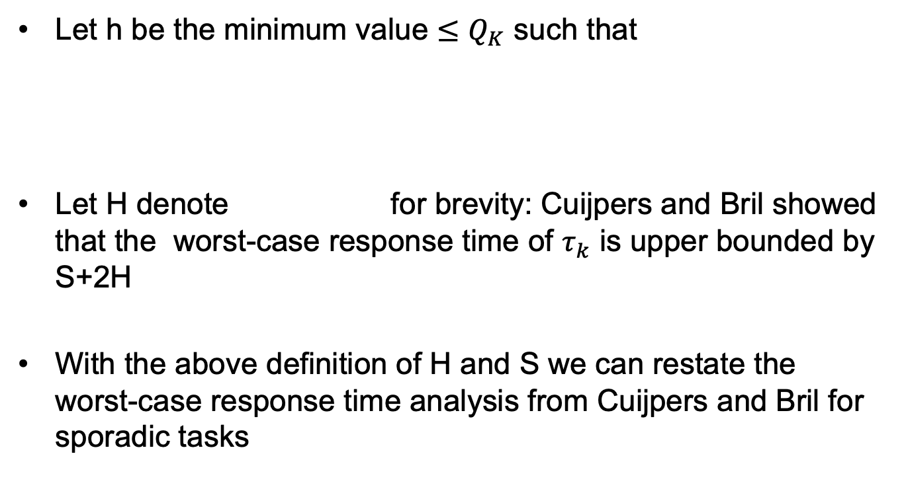
Worst-Case Response Time Analysis for One Single Task
Let h be the minimum value $≤Q_{K}$ such that
Let H denote for brevity: Cuijpers and Bril showed that the worst-case response time of $τ_{k}$ is upper bounded by S+2H
With the above definition of H and S we can restate the worst-case response time analysis from Cuijpers and Bril for sporadic tasks

Slide 51
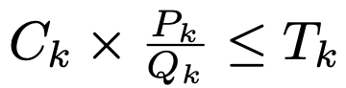
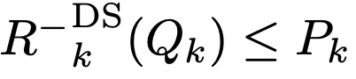
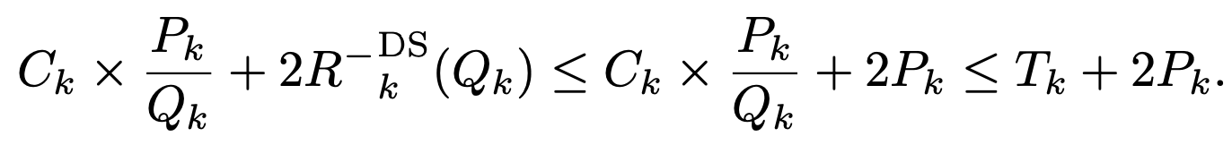
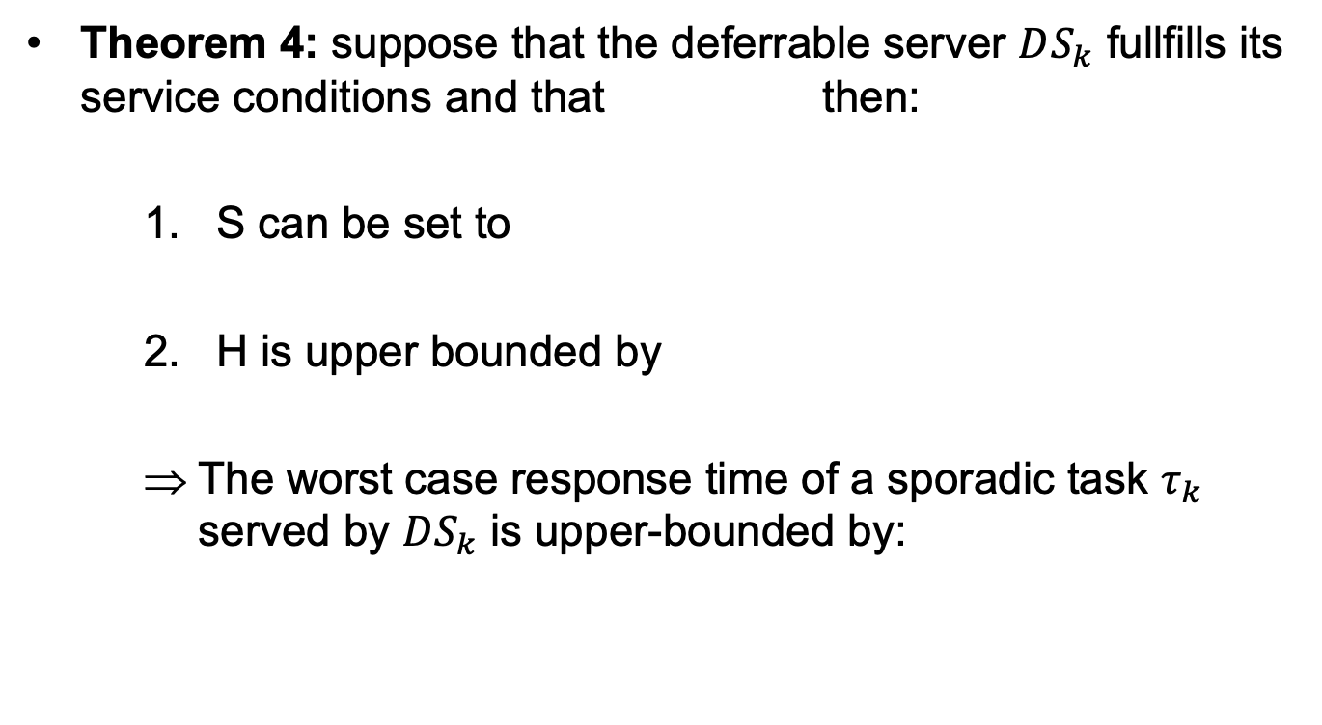
Worst-Case Response Time Analysis for One Single Task
Theorem 4: suppose that the deferrable server $DS_{k}$ fullfills its service conditions and that then:
S can be set to
H is upper bounded by
The worst case response time of a sporadic task $τ_{k}$ served by $DS_{k}$ is upper-bounded by:

Slide 52
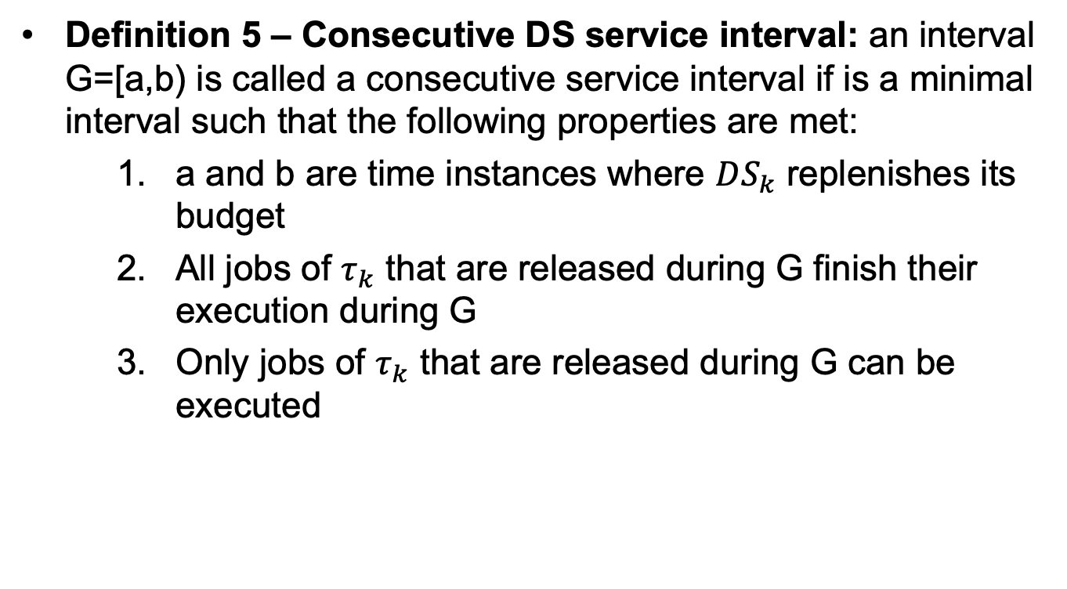
Worst-Case Response Time Analysis for One Single Task
Definition 5 – Consecutive DS service interval: an interval G=[a,b) is called a consecutive service interval if is a minimal interval such that the following properties are met:
a and b are time instances where $DS_{k}$ replenishes its budget
All jobs of $τ_{k}$ that are released during G finish their execution during G
Only jobs of $τ_{k}$ that are released during G can be executed

Slide 53
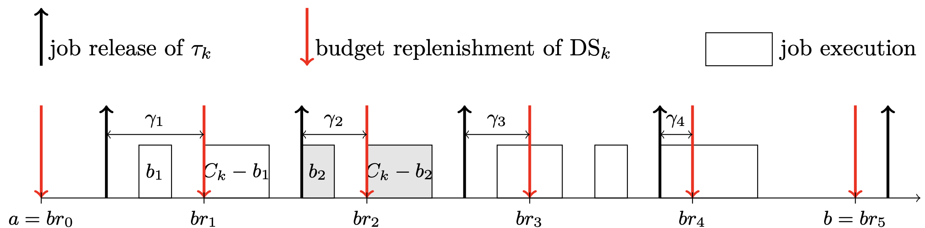
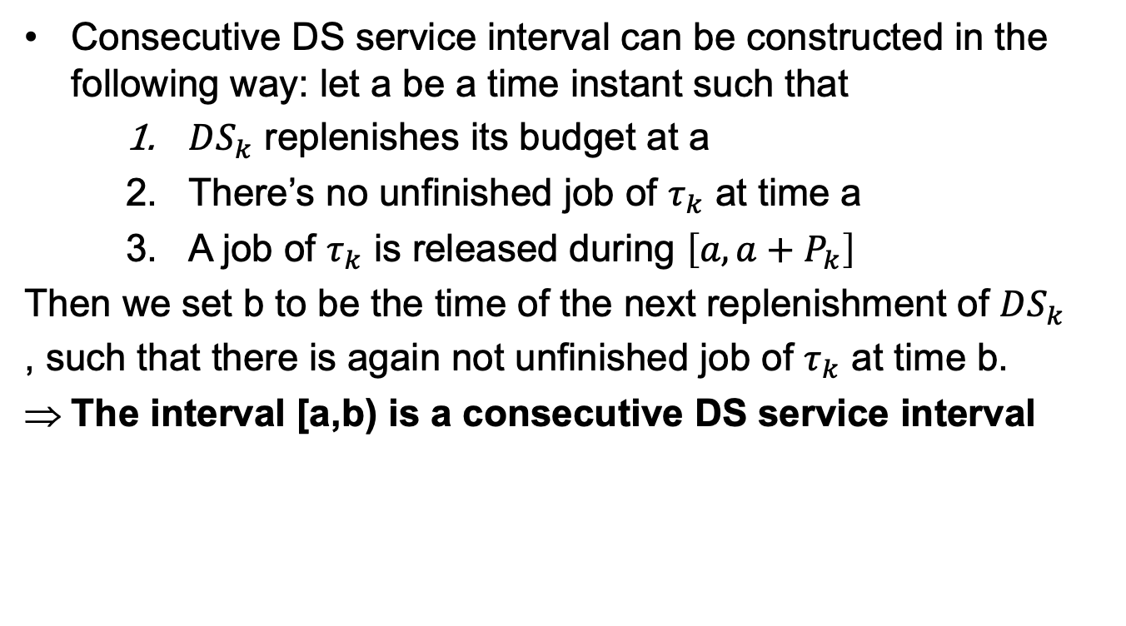
Worst-Case Response Time Analysis for One Single Task
Consecutive DS service interval can be constructed in the following way: let a be a time instant such that
$DS_{k}$ replenishes its budget at a
There’s no unfinished job of $τ_{k}$ at time a
A job of $τ_{k}$ is released during $\left[a,a+P_{k}\right]$
Then we set b to be the time of the next replenishment of $DS_{k}$
, such that there is again not unfinished job of $τ_{k}$ at time b.
The interval [a,b) is a consecutive DS service interval

Slide 54
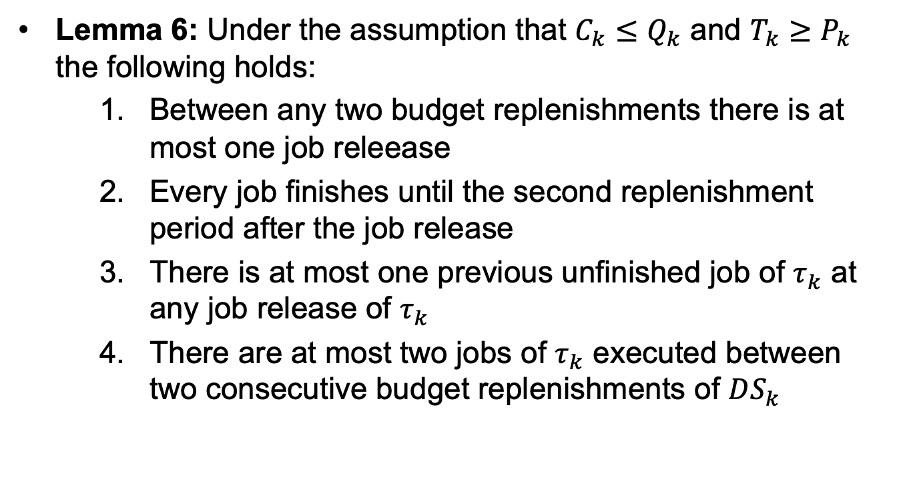
Worst-Case Response Time Analysis for One Single Task
Lemma 6: Under the assumption that $C_{k}≤Q_{k}$ and $T_{k}≥P_{k}$ the following holds:
Between any two budget replenishments there is at most one job releease
Every job finishes until the second replenishment period after the job release
There is at most one previous unfinished job of $τ_{k}$ at any job release of $τ_{k}$
There are at most two jobs of $τ_{k}$ executed between two consecutive budget replenishments of $DS_{k}$

Slide 55
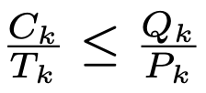
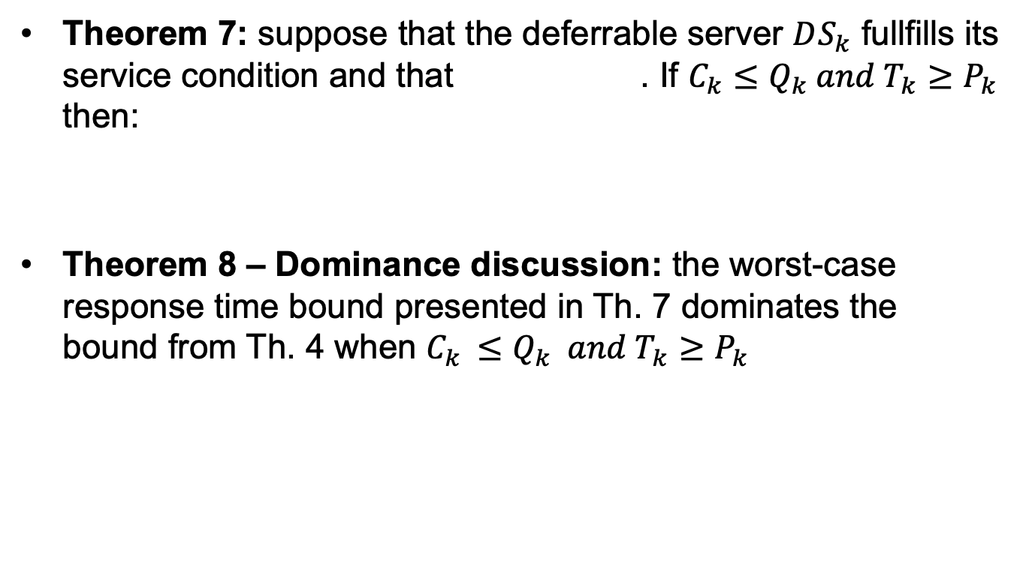
Worst-Case Response Time Analysis for One Single Task
Theorem 7: suppose that the deferrable server $DS_{k}$ fullfills its service condition and that . If $C_{k}≤Q_{k} and T_{k}≥P_{k}$ then:
Theorem 8 – Dominance discussion: the worst-case response time bound presented in Th. 7 dominates the bound from Th. 4 when $C_{k }≤Q_{k} and T_{k}≥P_{k}$

Slide 56
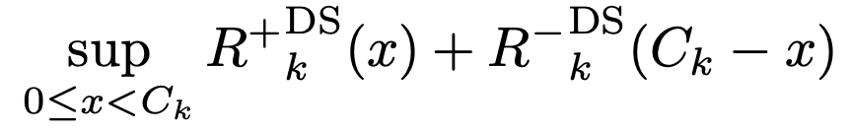
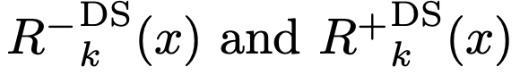
Worst-Case Response Time Analysis for One Single Task
For the computation of the worst-case response time upper bound presented in Th. 7 the supremum
has to be computed
Let’s discuss a method to do this efficiently without computing the values for 1 at every point using fixed-point iterations
In particular the interection between the functions t -> t and t -> I(t)+x is computed

Slide 57
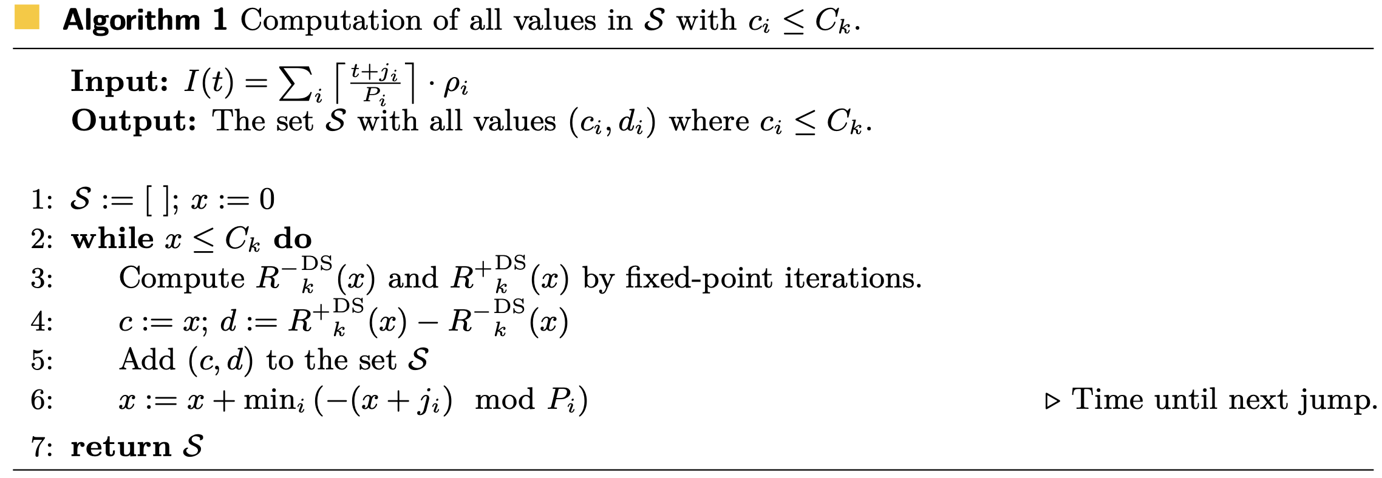
Worst-Case Response Time Analysis for One Single Task
The efficient presentation and formulation presented in this section is based on the observation that
coincide and grow linearly if the intersection with I+x is on a plateau

Slide 58
Architecture Model
The most Cyber-Physical Systems (CPS) applications are specialized and functionally dedicated tasks and can be implemented as single-purpose appliances
CPS applications provide an excellent target for unikernels
The case-study results are linked to the Xen hypervisor, so we are going to see briefly what’s Xen and how it works

Slide 59
Architecture Model: Overview on Xen hyervisor
Xen is a type 1 hypervisor and allows for consolidation of multiple systems on a single platform
Xen runs directly on host’s hardware and is the first software layer to execute after the bootloader
The hypervisor is responsible for managing hardware resources, including CPUs and memory
It also handles timers and scheduling of VMs

Slide 60
Architecture Model: Scheduling Architecture
Specific to Xen is a privileged VM called Domain 0
Domain 0 is the first VM to load under Xen, and holds the drivers to the underlying hardware and this is also where the toolstack resided that enables management of further VMs
Domain 0 is typically deployed on Linux
The drivers consist of two parts:
Front-end: situated in the guest VM
Back-end: resided in Domain 0
Both are isolated and communicate through shared memory

Slide 61
Architecture Model: Scheduling Architecture
The scheduling decision on Xen is split into two tiers:
Bottom tier: constituted by the hypervisor scheduler which assigns the vCPUs to pCPUs
Upper tier: consists of the guest operating system schedulers within VMs, which in turn assigns their threads to vCPUs
The splitting is needed for 2 reasons:
Possibility to abstract physical resources into logical resources
Allows the hypervisor to enforce timing isolation between the concurrently running VMs

Slide 62
Architecture Model: Scheduling Architecture
This architecture allows for high resource utilization while at the same time preventing any fault or compromised VM from hijacking system resources
One sporadic task per server aligns well with the concept of unikernels by which CPS applications are deployed as single tasked VMs
Due to the fact that each of our unikernels host a single task, there is no point of assigning more than one vCPU per unikernel

Slide 63
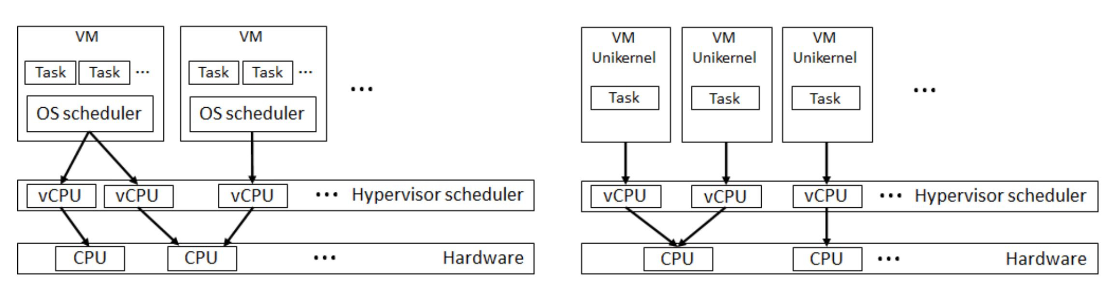
Architecture Model: Scheduling Architecture

Slide 64
Architecture Model: Real-Time Networking
CPS applications commonly assume distributed architectures
The I/O processing of network packets is a matter of particular importance
Xen handled packet processing in Domain 0 where the network driver resides
Each instantiated VM under Xen is connected to a dedicated virtual network interface (VIF) and a corresponding dedicated VIF-thread

Slide 65
Architecture Model: Real-Time Networking
By default the VIF-thread in Xen are scheduled independently of the priority of their VMs
This can lead to priority violation: the order of packet processing mismatches the priority of vCPUs
In order to solve this issue, we align the priorities of the packet processing threads with the corresponding priorities of the vCPU in the hypervisor scheduler

Slide 66
Architecture Model: Design Principles
In our model each vCPU is implemented as a deferrable server, described by its capacity and replenishment period
Due to the adaptation to unikernel each vCPU has only one task assigned to it
The vCPU is released under the sporadic task activation
Budget: amount of time the vCPU is set to the given capacity at its replenishment periodically

Slide 67
Architecture Model: Design Principles
The budget of the vCPU is set to the given capacity at its replenishment periodically
The vCPU can either be:
Runnable: it consumes its budget
Blocked: it doesn’t consumes its budget
A CPU with depleted budget will not be scheduled
If there are no eligible vCPUs, the hypervisor will schedule a idle vCPU

Slide 68
Architecture Model: Design Principles
As vCPU are implmented as deferrable servers, they can defer their budget to be used at a later time
However the budget cannot be preserved and transferred into the next period => budgets that were not consumed during their current periods are lost
Our implementation relies on partitioned queues i.e. each pCPU possesses and manages its own run queue of vCPUs
Priorities are statically assigned to the vCPU according to their replenishment periods following the rate-monotonic (RM) policy

Slide 69
Architecture Model: Design Principles
The utilization bound ln(3/2) ≈ 0.40546 guarantees the sufficient service condition of the deferrable servers on one physical processor
Each time a vCPU is assigned to a run queue, the vCPU is inserted accordingly to its priority
In the case of the RM algorithm the highest priority is given to the VM with the shortes replenishment period

Slide 70
Architecture Model: Implementation on Xen
The Xen hypervisor provides an interface to schedulers by exposing an abstract scheduler struct which contains pointers to functions which have to be implemented when adding a new scheduler on Xen
The scheduler policy independent code is situated in the schedule.c file
The most important function in schedule.c is schedule()
In order to choose the next vCPU to run, it deschedules the currently running vCPU and calls the specialized function do_schedule()

Slide 71
Architecture Model: Implementation on Xen
In our model we have extended Xen with out own scheduler that implements our deferrable server model
do_schedule() functions:
Updates the bookkeeping (consumed budget) for the currently running vCPU
Chooses the next vCPU to run from the top of the run queue
=> In case there are no eligible vCPUs to run, the algorithm returns the idle vCPU

Slide 72
Architecture Model: Implementation on Xen
Budget replenishment functionality is transferred into timers
For each of the vCPUs a timer is instantiated with a period that equals the replenishment period of the task
The replenishment itself is happening inside the timer handler

Slide 73
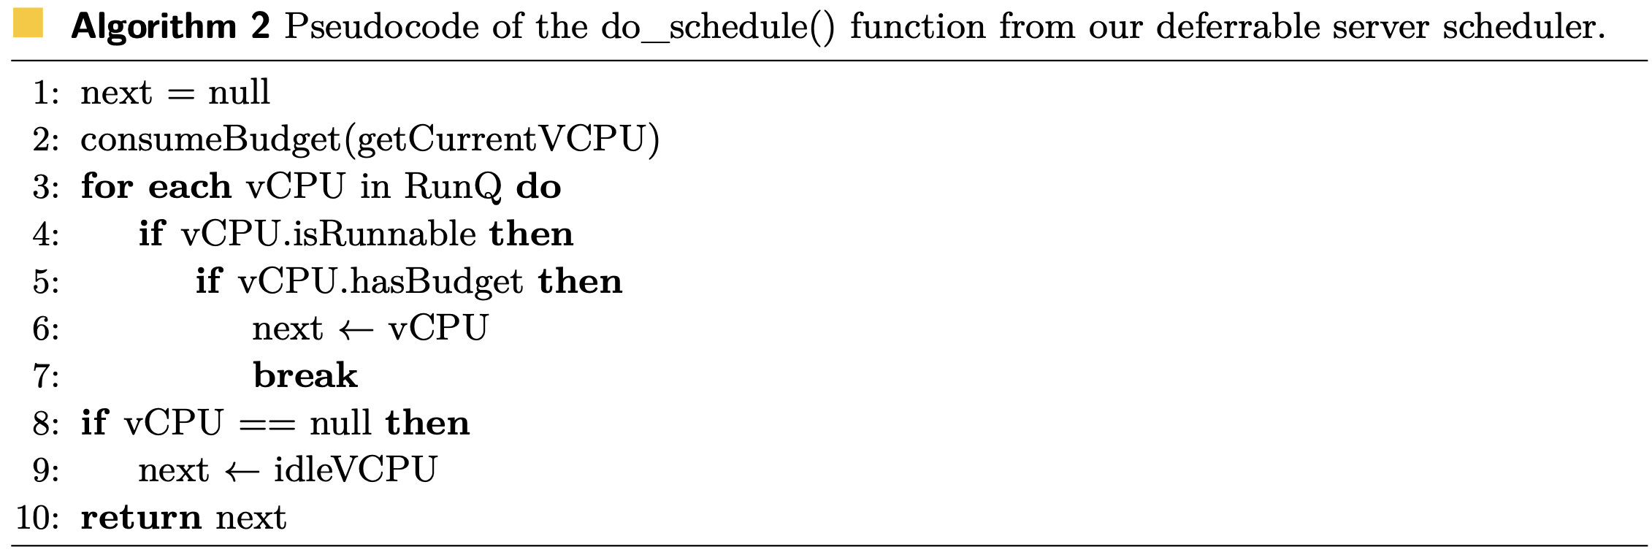
Architecture Model: Implementation on Xen

Slide 74
Experiment Setup
Platform: Intel NUC i5-8259U (4 cores @ 2.3 GHz), Turbo/HT/power mgmt disabled; Ubuntu 20.04 in Dom0
Hypervisor: Xen 4.14.1 with a custom Deferrable Server (DS) scheduler; partitioned RM (one vCPU/server per physical core queue)
Workload: 4 periodic tasks deployed as unikernel VMs on one pCPU; Dom0 on a separate pCPU

Slide 75
Experiment Setup
Networking alignment: VIF-thread priorities aligned with VM priorities to avoid priority inversions in packet processing
Network stack overhead (host): worst-case ≤ 250 µs, average 157 µs—included in WCRT bounds

Slide 76
Measurements Methodology
Benchmark: UDP client–server; client triggers computation in each unikernel; server replies when done
Three latencies captured per request/response:
Task response time (release→finish) via SystemTap hooks at L2 in Dom0 TCP/IP
Task execution time (in-VM), cycle-accurate (used to sanity-check WCET vs hardware)
Client round-trip time for plausibility checks
Samples:
22,000 response-time measurements
Bounds adjusted by ≤ 250 µs worst-case host networking latency

Slide 77
Case-Study Results: Tasks and Servers
VM | Task (T, C) [ms] | DS (P, Q) [ms] | WCRT bound (incl. net)
VM1 | T=12, C=1 | P=10, Q=2 | 1.25 ms
VM2 | T=20, C=4 | P=20, Q=4 | 12.25 ms
VM3 | T=60, C=8 | P=50, Q=10 | 26.25 ms
VM4 | T=130, C=9 | P=100, Q=10 | 79.25 ms
Each VM hosts a single task and the budget is consumed only while serving that task.

Slide 78
Case-Study Results: Measured vs Bound
No outliers across 22k samples → deterministic behavior under DS scheduling
Measured WCRTs (incl. network) vs computed bounds:
VM1: 1.215 ms (bound 1.25 ms), σ 0.047 ms
VM2: 5.83 ms (bound 12.25 ms), σ 0.49 ms
VM3: 14.03 ms (bound 26.25 ms), σ 2.02 ms
VM4: 27.83 ms (bound 79.25 ms), σ 5.14 ms
Observation: bounds hold for all VMs; conservatism increases at lower priorities (larger periods)

Slide 79
Numerical Simulation: Tightness of Analysis
Goal: compare new WCRT bound (Theorem 7) vs RTC-derived bound (Theorem 4)
Synthesis (per test):
n ∈ {10, 50, 100} servers; UUniFast for Ui summing to U.
Pi log-uniform in [1, 100] ms; Qi = Pi·Ui; Ti uniform in [1.0 Pi, 1.5 Pi]; Ci uniform in [0.5 Qi, 1.0 Qi]
Priorities by rate-monotonic
Service condition constraint: U = Σ(Qi/Pi) ≤ ln(3/2) ≈ 0.40546 to ensure DS service feasibility
Results (boxplots of WCRTOur / WCRTSOTA):
Median improvement ≈ 90.5% (across n = 10, 50, 100).
At U=0.40, median improvement ≈ 84.4% (still strong).
Trend: gap closes as U increases, but new analysis remains substantially tighter within service-feasible region.

Slide 80
What These Numbers Means: Takeaways
Feasibility in practice: unikernel-per-task + DS on Xen yields predictable response times; measured WCRTs < bounds for all VMs
Networking accounted for: host network stack adds ≤ 0.25 ms (avg 0.157 ms) and is included in the analysis for fair end-to-end bounds
Analysis tightness: new bound is ~85–90% tighter than RTC-derived bound in the service-feasible region (U ≤ ln(3/2)), enabling higher utilization without violating deadlines
Design implication: “one task per unikernel per vCPU” simplifies timing (no guest scheduler), reduces jitter, and aligns with RM-based DS provisioning

Slide 81
Conclusions
In this work we proposed to leverage the scheduling architecture of unikernel-based virtualization to facilitate the schedulability of deferrable servers
We presented how to derive the worst-case response time analysis under practical scenarios
The evaluation results of the experiment show that out analysis outperforms the restated analysis based on the state-of-the-art
In addition we showed that the unikernel-based architecture can be effectively implemented on top of the Xen hypervisor

Slide 82
Major Unikernel Distributions
Brief overview about the main software distributions

Slide 83
MirageOS
MirageOS is a LibraryOS Unikernel compiling Ocaml apps into a sealed VM image
Runs on Xen hypervisor (paravirtualized) and via Solo5 on KVM-like monitors
Supports x84-64 and ARM architectures
Designed for cloud but also applied in edge scenarios

Slide 84
OSv
OSv is a general-purpose unikernel OS optimized for running a single linux application on a VM
Supports KVM/QEMU and Xen mainly x86-64
Provides a POSIX-like environment to run high-level language runtimes (JVM, Node.js …) in the cloud or edge

Slide 85
IncludeOS
IncludeOS is a minimal unikernel written in C++ for cloud services
Targets x86-64 virtual hardware and runs on KVM/QEMU
It focuses on small footprints and fast boot
Suitable for network functions or microservices on edge servers

Slide 86
Rumprun (NetBSD Rump Kernels)
Unikernel that uses NetBSD’s rump kernel to run POSIX applications as unikernels
Can run on Xen or KVM and reuse NetBSD drivers
It has been used for network appliances e.g. ClickOS uses rumprun base

Slide 87
Hypervisor and Hardware Platform Compatibility
Brief overview about the main platform supports

Slide 88
Xen Hypervisor
Widely used for unikernels, especially in early research
Xen’s paravirtualization allows unikernels to run with minimal emulation overhead
Many unikernels were designed for Xen on x86 and ARM
Xen supports real-time scheduling to meet CPS timing constraints

Slide 89
KVM and MicroVMs
Most unikernels run on KVM/QEMU as standard x86 or ARM VMs
Lightweight VMMs build on KVM to launch microVMs with minimal device emulation
An ideal match for unikernels’ small footprint
Combining unikernels with microVMs in order to maximize isolation and startup speed in FaaS platforms

Slide 90
Bare-Metal and Other Platforms
Unikernels generally rely on a hypervisor but some can run directly on hardware or as unikernel processes
Unikernel images can run on a hypervisor or on bare hardware, not requiring a host OS
The Unishyper project boots on embedded ARM/RISC-V devices without an OS, using a thin platform layer
Some unikernels can also run as a process on Linux for development

Slide 91
CPU Architectures
Initial unikernels targeted x86-64 but now many support ARM for IoT and mobile edges
RISC-V support is emerging e.g. Unikraft and Unishyper include RISC-V as a target architecture
Multi-platform support is becoming common in newer unikernels, reflecting the heterogeneous hardware in edge environments

Slide 92
Benefits of Unikernels for Edge Computing
Description and motivation of the advantages of unikernels for the edge computing field

Slide 93
Minimal Footprint and Fast Boot
Unikernels compile only the necessary OS functions and the single application into one image
Extremely small VM images and rapid boot times
For edge scenarios this means that more instances can run on resource-constrained nodes and services can scale up on-demand with virtually no startup delay
Unikernels can cold-start and be fully functionl within a few milliseconds
Far faster than traditional VMs

Slide 94
High Security by Design
Tiny attack surface by removing all unused OS components
Isolation and reduction of code results in fewer vulnerabilities
Studies note that a minimale unikernel image greatly increases security properties compared to general purpose OSs

Slide 95
Real-Time Performance
Unikernels avoid the overhead of a full OS, which benefits real-time behaviour
With a single address space and no kernel/userspace transitions, interrupt and scheduling latencies can be lower and more predictable
Each unikernel typically runs one application thread pinned to a vCPU, eliminating in-guest scheduing variability

Slide 96
Efficiency and Scalability
Running only what is needed yields extremely low memory and CPU overhead
Unikernels typically consume an order of magnitude of memory less than a Linux VM or even a minimal container
This means that edge nodes can run more services concurrently

Slide 97
Tailored Functionalities
Unikernels are single-purpose by design which fits with the microservice model often used at the edge
Developers select only the libraries needed, resulting in a custom OS for each application
This can be tuned for performance or footprint, it also improve adaptability
In edge computing where applications might be specialized, the ability to tailor the OS per app is a strength

Slide 98
Numbers at Glance
Some numerical results about unikernels

Slide 99
Startup and Footprint vs performance
Cold-Start and Image size:
Image: 1.9 MB (unikernel) vs. 109 MB (container)
Boot: 3.188 ms (unikernel) vs. 508.355 ms (container)
Throughput/compute:
REST (single thread):
Go: +38% req/s
Java: +16% req/s
Python: +15% req/s
Respect to containers
CPU-Bound:
Go: -3%
Java: +1%

Slide 100
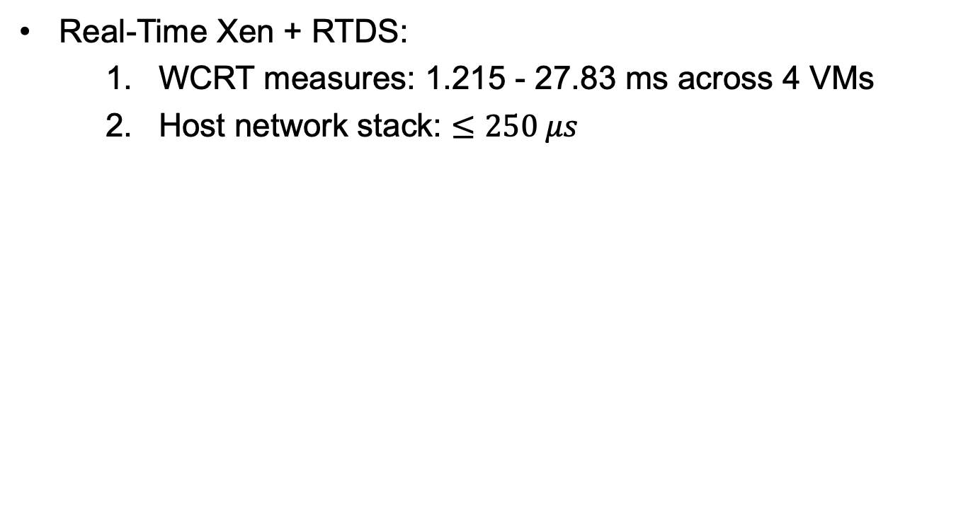
Startup and Footprint vs performance
Real-Time Xen + RTDS:
WCRT measures: 1.215 - 27.83 ms across 4 VMs
Host network stack: $≤250 μs$

Slide 101
Startup and Footprint vs performance
Metric | Container | Unikernel | Delta
Image size (Nginx) | 109 MB | 1.9 MB | −98%
Cold-start (Nginx) | 508.355 ms | 3.188 ms | ~169× faster
REST throughput (Go) | baseline | +38% | +38%
REST throughput (Java) | baseline | +16% | +16%
REST throughput (Python) | 351 ± 1 rps | 395 ± 1 rps | +15%
CPU-bound | — | ≈ parity | Go −3% / Java +1%

Slide 102
Benchmark and methods
REST testbed:
Java (Vert.x)
Go (net/http+Gorilla)
Python (Flask)
40 threads × 50k requests
OSv unikernels vs Docker
CPU-bound:
Bubble-sort workload
Log-scale timing
Same languages

Slide 103
Benchmark and methods
Edge/RT case:
Request/response timestamps inside Dom0 TCP/IP execution time clock-cycle precise
22k measurements
Boot/size test:
Prebuilt images: Unikraft and Docker Hub
ns-level boot script
du -s --si for image size; wrk+Prometheus/Grafana for load stats

Slide 104
Limitations, Future Outlook and Emerging Trends
Overview of the current limitations, future prospects and roadmap

Slide 105
Limitations
Orchestration and tooling: no Docker/K8s-grade ecosystem yet; formats and build tools differ across projects, so deploying/updating large fleets is still manual and brittle
Developer Adoption and Ecosystem: niche languages/APIs and scarce tooling slow onboarding; porting apps and debugging without shells/SSH is cumbersome
Fragmentation and Standardization: many incompatible approaches and ABIs; lack of standards makes swapping or orchestrating unikernels hard

Slide 106
Limitations
Language and Compatibility Constraints : often language-specific with partial POSIX; running existing binaries is experimental, so teams may maintain separate code paths
Debugging and Monitoring: minimal environments lack familiar probes (strace/perf,/proc); you rely on hypervisor tracing/instrumentation, raising ops effort
Peripheral and Device Support : limited drivers beyond virtio; true bare metal needs custom NIC/storage/sensor drivers or offloading to a host OS, adding complexity

Slide 107
Future Outlook and Emerging Trends
MicroVM and Container Ecosystem Integration: converging to VM isolation with container agility; expect build/orchestrate flows that feel like Docker/K8s
Scalability and Orchestration: unified schedulers, image registries, and lifecycle tools tailored to unikernels plus standardized image metadata
Real-Time and Safety-Critical Adoption: better RT schedulers and timing introspection could bring unikernels into mixed-criticality and certified domains

Slide 108
Future Outlook and Emerging Trends
Security and Isolation Enhancements: intra-unikernel isolation (MPK/MTE), immutable builds, and memory-safe stacks (e.g., Rust) to harden edge deployments
Edge-Native Apps and Libraries: “Compile-to-unikernel” frameworks and accelerator-aware images (e.g., TFLite) to make ML and edge services turnkey and dense

Slide 109
Real-World Deployment Scenarios
IoT Gateways and Edge Appliances: tiny, fast-boot services for protocol translation, filtering, and encryption; strong isolation limits blast radius on compromised nodes
5G/6G Telco Edge (MEC/NFV): lightweight, quickly (cold)-startable network functions (NAT, FW, UPF) at cell sites; lower attack surface and on-demand provisioning
Autonomous Systems and Robotics: deterministic, low-overhead control/sensor modules per task; quick startup and isolation suit compute-constrained robots/drones

Slide 110
Real-World Deployment Scenarios
Serverless / FaaS: paired with microVMs for millisecond cold starts and high density; “unikernel-as-a-function” reduces per-invocation overhead.
Embedded and CPS: multiple isolated RT tasks consolidated on one board under a hypervisor; analyzable timing with strong fault isolation.

Slide 111
References

Slide 112
Peer-reviewed papers
[1] K.-H. Chen, M. Günzel, B. Jablkowski, M. Buschhoff, and J.-J. Chen, “Unikernel-Based Real-Time Virtualization,” ECRTS 2022, LIPIcs, pp. 6:1–6:22, 2022. doi:10.4230/LIPIcs.ECRTS.2022.6
[2] C. G. Paulus, D. Socci, C. Marquezan, and L. R. P. M. Vitório, “Unishyper: Safe, memory-efficient, and fast hypervisor using Rust,” Middleware ’23 Companion, ACM, 2023.
[3] H. Zhao, Z. He, and L. Wang, “An Edge Computing Architecture Based on Unikernel,” (preprint / proceedings copy).
[4] A. Marnerides, M. Psarakis, Enhancing Edge Computing with Unikernels in 6G Networks, University of Manchester repository, 2023.
[5] A. Ahuja and V. Jain, “Challenges and Opportunities for Unikernels in Machine Learning Inference,” Proc. 9th Int’l Conf. on Reliability, Infocom Technologies and Optimization (ICRITO), 2021.
[6] A. A. Nizar, S. A. Karimah, and E. M. Jadied, “Analysis of Virtualization Performance on Resource Efficiency Using Containers and Unikernel,” 2024 Int’l Conf. on Artificial Intelligence, Blockchain, Cloud Computing, and Data Analytics (ICoABCD), 2024.
[7] T. Goethals, M. Sebrechts, A. Atrey, B. Volckaert, and F. De Turck, “Unikernels vs Containers: An In-Depth Benchmarking Study in the Context of Microservice Applications,” 2018 IEEE 8th Int’l Symposium on Cloud and Service Computing (SC2), 2018
[8] J. Talbot, P. Pikula, C. Sweetmore, S. Rowe, H. Hindy, C. Tachtatzis, R. Atkinson, and X. Bellekens, “A Security Perspective on Unikernels,”.
[9] A. Wollman and J. Hastings, “A Survey of Unikernel Security: Insights and Trends from a Quantitative Analysis,” Cyber Awareness and Research Symposium (CARS), 2024.

Slide 113
Official Project sites
[10] OSv unikernel: official site and docs.
[11] MirageOS: project home (OCaml unikernels) / org repos.
[12] IncludeOS: project resources (C++ unikernel) — current status mostly via project repos/news.
[13] NanoVMs / Nanos: vendor and OSS resources (Rust/C apps as unikernels; tutorials).
[14] Solo5: unikernel sandbox / base layer (docs & architecture).
[15] Xen RTDS (Real-Time Deferrable Server) scheduler: overview, docs, and tooling.

